Slide 1












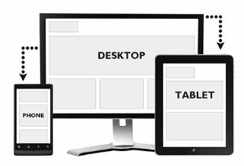







Local server
Front end
Editors
Server space
FTP server

Slide 2


What is the DOM
1
2
You can give orders to the boxes
It work with tags that contain tags </>
Class or Id
3
4
2
2
3
3
4
4

Slide 3
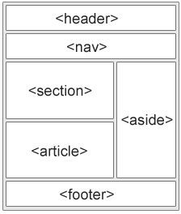
HTML is a system that trough tags and properties manage blocks of information that the users will see on in witch user can put information.
Events
Style atribute
They work like if it was java
The conection with css
XHTML
You can nest elements, it is the place to connect all the pages
Sintax
atributes
<></>
< element attribute = “ection”;>
<div style = “color:blue;”>
Id
Class
Href
width="104" height="142">
Tags – elements
Line and block elements
Entities/simbol
<></>
<>
Unicode - UTF-8
<form><form/>
Structure tags
<head><head/>
<body></body>
<foot></foot>
Linck tags tags
<link><link/>
<script></script>
<style></style>
Media
Video
Audio
Images
Text tag
<h1>
<p>
<table>
<a>
API
<embed>, <object>
Graphic design
<canvas>
<svg>
<div></div>
<span></span>
Youtube
Geo-location
Drag – and Drop
localstorage
<youCanCreateNames>
<youCanCreateNames />
Shiv Solution

Slide 4
Html
‘’ and “” are the same but use for diferentiate
It works with tags
Atribute
<!DOCTYPE html>
<html lang="en-US">
<head>
<meta name="description" content="Free Web tutorials on HTML and CSS">
<title>Page Title</title>
</head>
<body>
<h1><br>This</br> is a <hr>Heading</hr></h1>
<p>This is a paragraph.</p>
<!– i am aweosme -->
</body>
</html>
<!DOCTYPE html>
Href
Src
Width
Height
Alt
Title
Style
id
<img src="w3schools.jpg" width="104" height="142">
Links
Image
<a href="http://www.w3schools.com">This is a link</a>
<a href="http://www.w3schools.com/" target="_blank">Visit W3Schools!</a>
you want to go
<img src="w3schools.jpg" alt="W3Schools.com" width="104" height="142">
Awesome invisible bookmark to link diferent parts of the page
<a id="tips">Useful Tips Section</a>
you click to go
<map> - to click a specific part of an image
<a href="#tips">Visit the Useful Tips Section</a>|
Talk about types jpg, png, gif

Slide 5
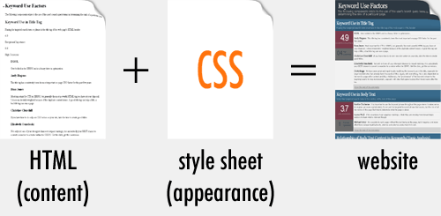
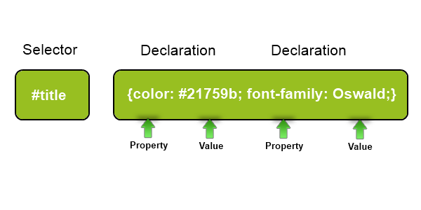
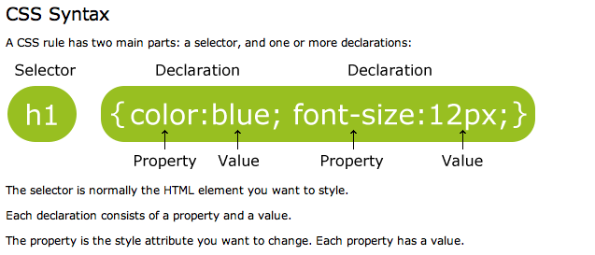

Slide 6
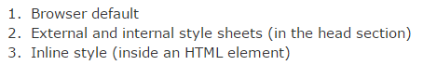
Priority
The basic CSS
Multiple selectors
body { background-color: #d0e4fe; } h1 { color: orange; text-align: center; } p { font-family: "Times New Roman"; font-size: 20px; }
/* This is a comment */
h1, h2, p { text-align: center; color: red; }
The class
The Id
.center { text-align: center; color: red; }
<Doctype html>
<p id="para1“> aweosme </p>
<style>
#para1 { text-align: center; color: red; }
Only affects the specific selectors
p.center { text-align: center; color: red; }

Slide 7
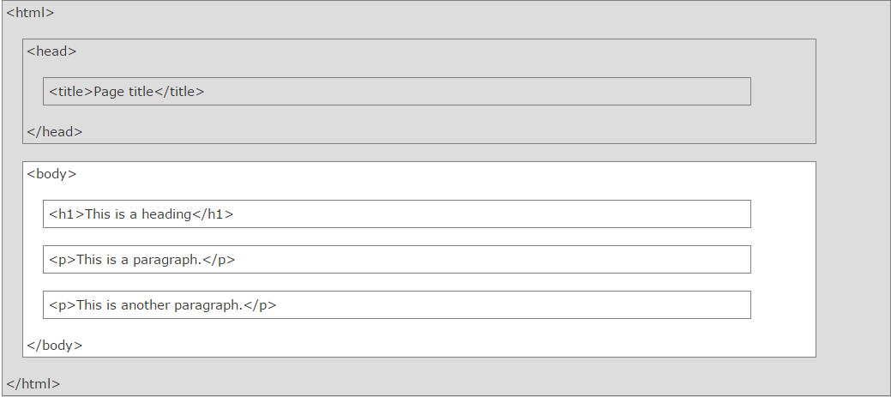
This is how the computer interprets HTML5, what you see on the web is the white part
<head> <link rel="stylesheet" type="text/css" href="mystyle.css"> </head>
This is how we link files
<script> | Defines a client-side script
<noscript> | Defines an alternate content for users that do not support client-side scripts

Slide 8
The cool and useful tags
<pre></pre> -- like a super <p></p>
Atributes
Tag | Description
<b> | Defines bold text
<em> | Defines emphasized text
<i> | Defines italic text
<small> | Defines smaller text
<strong> | Defines important text
<sub> | Defines subscripted text
<sup> | Defines superscripted text
<ins> | Defines inserted text
<del> | Defines deleted text
<mark> | Defines marked/highlighted text
Style
<body style="property:value“ > </body>
Style css properties
<abbr> | Defines an abbreviation or acronym
<address> | Defines contact information for the author/owner of a document
<bdo> | Defines the text direction
<blockquote> | Defines a section that is quoted from another source
<dfn> | Defines the definition of a term or an abbreviation.
<q> | Defines a short inline quotation
<cite> | Defines the title of a work
Use the style attribute for styling HTML elements
Use background-color for background color
Use color for text colors
Use font-family for text fonts
Use font-size for text sizes
Use text-align for text alignmen
Entity

Slide 9
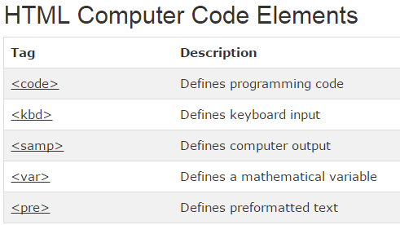
Tag | Description
<iframe> | Defines an inline frame
<base> | Defines a default address or a default target for all links on a page

Slide 10
Table and list
Tag | Description
<table> | Defines a table
<th> | Defines a header cell in a table
<tr> | Defines a row in a table
<td> | Defines a cell in a table
<caption> | Defines a table caption
<colgroup> | Specifies a group of one or more columns in a table for formatting
<col> | Specifies column properties for each column within a <colgroup> element
<thead> | Groups the header content in a table
<tbody> | Groups the body content in a table
<tfoot> | Groups the footer content in a table
<table style="width:100%"> <tr> <td>Jill</td> <td>Smith</td> <td>50</td> </tr> <tr> <td>Eve</td> <td>Jackson</td> <td>94</td> </tr> </table>
<th> can also use table head
<caption> can also put a caption , at the beginning
Tag | Description
<ul> | Defines an unordered list
<ol> | Defines an ordered list
<li> | Defines a list item
<dl> | Defines a description list
<dt> | Defines the term in a description list
<dd> | Defines the description in a description list
<dl> <dt>Coffee</dt> <dd>- black hot drink</dd> <dt>Milk</dt> <dd>- white cold drink</dd> </dl>

Slide 11
The most efficient way to style a block is by using div elements and together with class and id properties
Block like <div>or inline element like <span>
<di> </div>
<span></<span>

Slide 12
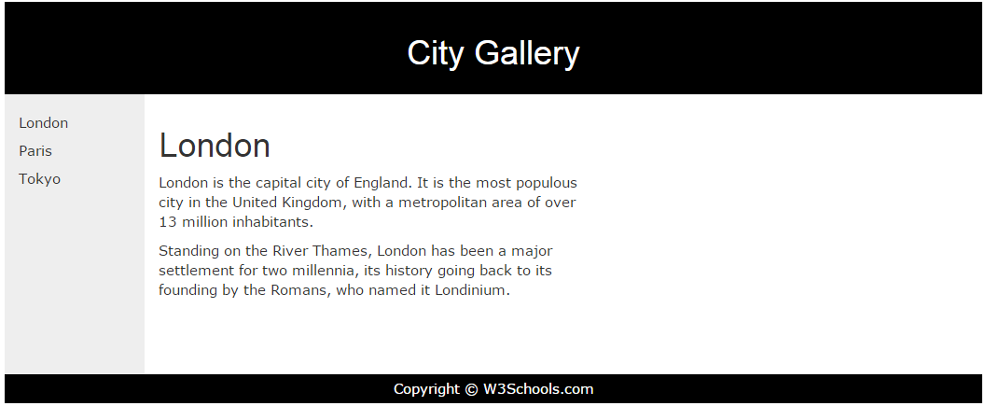
Classes
A class or is a html attribute that using ccs makes easy to give a standard style to a page
.cities { background-color:black; color:white; margin:20px; padding:20px; }
span.red {color:red;}
In HTML
<div class="cities">

Slide 13
Resposive web design
http://www.w3schools.com/html/html_responsive.asp
Two main components
To float things
And to percentage things

Slide 14
Adobe CC color
https://color.adobe.com/es/

Slide 15
http://designmodo.com/startup/

Slide 16
Form, imput element --- action , type attribute
<!DOCTYPE html>
<html>
<body>
<form action="action_page.php">
<fieldset>
<legend>Personal information:</legend>
First name:<br>
<input type="text" name="firstname" value="Mickey">
<br>
Last name:<br>
<input type="text" name="lastname" value="Mouse">
<br><br>
<input type="submit" value="Submit">
<select name="cars">
<option value="volvo">Volvo</option>
<option value="saab">Saab</option>
<option value="fiat">Fiat</option>
<option value="audi">Audi</option>
</select>
<textarea name="message" rows="10" cols="30"> The cat was playing in the garden. </textarea>
<button type="button" onclick="alert('Hello World!')">Click Me!</button>
</fieldset>
</form>
</body>
</html>
<form action="action_page.php" method="GET" target="_blank" accept-charset="UTF-8" enctype="application/x-www-form-urlencoded" autocomplete="off" novalidate> . form elements . </form>

Slide 17
Forms – new elements
Tag | Description
<form> | Defines an HTML form for user input
<input> | Defines an input control
<textarea> | Defines a multiline input control (text area)
<label> | Defines a label for an <input> element
<fieldset> | Groups related elements in a form
<legend> | Defines a caption for a <fieldset> element
<select> | Defines a drop-down list
<optgroup> | Defines a group of related options in a drop-down list
<option> | Defines an option in a drop-down list
<button> | Defines a clickable button
<datalist> | Specifies a list of pre-defined options for input controls
<keygen> | Defines a key-pair generator field (for forms)
<output> | Defines the result of a calculation
HTML5 added several new input types:
color
date
datetime
datetime-local
email
month
number
range
search
tel
time
url
week

Slide 18
<canvas> and <svg> --- a container for graphics
<!DOCTYPE html>
<html>
<body>
<canvas id="myCanvas" width="200" height="100" style="border:1px solid #d3d3d3;">
Your browser does not support the HTML5 canvas tag.</canvas>
<script>
var c = document.getElementById("myCanvas");
var ctx = c.getContext("2d");
ctx.beginPath();
ctx.arc(95,50,40,0,2*Math.PI);
ctx.stroke();
</script>
</body>
</html>
<svg height="130" width="500"> <defs> <linearGradient id="grad1" x1="0%" y1="0%" x2="100%" y2="0%"> <stop offset="0%" style="stop-color:rgb(255,255,0);stop-opacity:1" /> <stop offset="100%" style="stop-color:rgb(255,0,0);stop-opacity:1" /> </linearGradient> </defs> <ellipse cx="100" cy="70" rx="85" ry="55" fill="url(#grad1)" /> <text fill="#ffffff" font-size="45" font-family="Verdana" x="50" y="86">SVG</text> Sorry, your browser does not support inline SVG. </svg>

Slide 19
<header>
<section>
<footer>
<aside>
https://github.com/afarkas/html5shiv
http://html5boilerplate.com/

Slide 20
<video>
<video width="320" height="240" autoplay> <source src="movie.mp4" type="video/mp4"> <source src="movie.ogg" type="video/ogg"> Your browser does not support the video tag. </video>
<audio controls> <source src="horse.ogg" type="audio/ogg"> <source src="horse.mp3" type="audio/mpeg"> Your browser does not support the audio element. </audio>

Slide 21
<iframe> <embed> and <object> from plog in or call other html page
<embed width="100%" height="500px" src="snippet.html">
<iframe width="420" height="315" src="http://www.youtube.com/embed/XGSy3_Czz8k?autoplay=1"> </iframe>

Slide 22
Geo location
getCurrentPosition()
Property | Description
coords.latitude | The latitude as a decimal number
coords.longitude | The longitude as a decimal number
coords.accuracy | The accuracy of position
coords.altitude | The altitude in meters above the mean sea level
coords.altitudeAccuracy | The altitude accuracy of position
coords.heading | The heading as degrees clockwise from North
coords.speed | The speed in meters per second
timestamp | The date/time of the response

Slide 23
Drag and drop – it is an attribute
<img draggable="true">
HTML Local Storage Objects
window.localStorage - stores data with no expiration date
window.sessionStorage - stores data for one session (data is lost when the tab is closed)

Slide 24
Manifesto Cache is for making webpages that load ofline
CACHE MANIFEST # 2012-02-21 v1.0.0 /theme.css /logo.gif /main.js NETWORK: login.asp FALLBACK: /html/ /offline.html
To say what should be load offline
To show what should never load, a * will mean everything else
NETWORK
*
The file should be called name.appcache
What to show id there is no connection
<!DOCTYPE HTML> <html manifest="demo.appcache"> ... </html>
Call Apache in HTML

Slide 25
HTML5 Web Workers

Slide 26
Html events

Slide 28
Priority
The basic CSS
Multiple selectors
body { background-color: #d0e4fe; } h1 { color: orange; text-align: center; } p { font-family: "Times New Roman"; font-size: 20px; }
/* This is a comment */
h1, h2, p { text-align: center; color: red; }
3 ways to add style to a HTML
External style sheet
Internal style sheet
Inline style
<head> <link rel="stylesheet" type="text/css" href="mystyle.css"> </head>
The class
The Id
.center { text-align: center; color: red; }
<Doctype html>
<p id="para1“> aweosme </p>
<style>
#para1 { text-align: center; color: red; }
Only affects the specific selectors
p.center { text-align: center; color: red; }

Slide 30
http://www.w3schools.com/css/tryit.asp?filename=trycss_image_gallery
The different types of selectors
general sibling selector
Div ~ p {}
all <p> elements that are siblings of <div> elements
Combinators
adjacent sibling selector
Div + p {}
<p> elements that are placed immediately after <div> elements
Div p { xx:xx;}
Div > p {xx:xx;}
Div + p {}
Div ~ p {}
Attribute Selectors
Id
#makeUpAName { xx:xx; }
class
.makeUpAName { xx:xx; }
descendant selector
Div p {}
selects all <p> elements inside <div> elements:
child selector
Div > p {}
<p> elements that are immediate children of a <div>
Eelement
P {xx:xx;}
a{}
Table{}
You can group elements
h1, h2, p { text-align: center; color: red; }
Class that only affects a specific element
p.makeUpAName { xx:xx; }
Pseudo-classes
Style that only act over characteristics of elements
selector:pseudo-class { property:value; }
Or
Selector.class:pseudo-class { property:value; }
::selection { color: red; background: yellow; }
Pseudo-elements
/* unvisited link */ a:link { color: #FF0000; } /* visited link */ a:visited { color: #00FF00; } /* mouse over link */ a:hover { color: #FF00FF;
} /* selected link */ a:active { color: #0000FF; }
h1::before { content: url(smiley.gif); }
p::first-letter { color: #ff0000; font-size: xx-large; }
P:first-child
a:hover
a:active
a:visited
selector::pseudo-element { property:value; }
p::first-line {}
Are already predefine in CSS you don’t make up the names

Slide 31
The CSS properties
Take into account that the editor can give you the options of the value of the property. Making important to know the properties by memory but not the values
Background
Text formatting
Link formatting
.body { background-color: #b0c4de; }
h1 { color: #00ff00;
font-size: 40px; }
a { color: #FF0000; }
p.date { text-align: right;
}
.body {
background-image: url("paper.gif");
}
font-size: 2.5em; /* 40px/16=2.5em */
/* unvisited link */ a:link { color: #FF0000;
background-color: #B2FF99; } /* visited link */ a:visited { color: #00FF00; } /* mouse over link */ a:hover { color: #FF00FF;
} /* selected link */ a:active { color: #0000FF; }
h2 { text-decoration: line-through; }
p { font-family: "Times New Roman", Times, serif; }
body { background-image: url("gradient_bg.png"); background-repeat: repeat-x; /* it could be also repeat-x to repeat the image over the vertical angle */ }
p.lowercase { text-transform: lowercase;
font-style: italic; }
a:hover MUST come after a:link and a:visited
a:active MUST come after a:hover
http://www.w3schools.com/css/css_text.asp -- you can go crazy and change event the space between letters

Slide 32
The CSS properties
Take into account that the editor can give you the options of the value of the property. Making important to know the properties by memory but not the values
List
Table
Link formatting
table, th, td { border: 1px solid black; }
ul.classa { list-style-type: circle; } ul.classb { list-style-type: square; }
table { border-collapse: collapse; } table, th, td { border: 1px solid black; }
ul { list-style-image: url('sqpurple.gif'); }
table { width: 100%; } th { height: 50px; }
th { text-align: left; }
http://www.w3schools.com/css/css_list.asp
td { height: 50px; vertical-align: bottom;
padding:15px; }

Slide 33
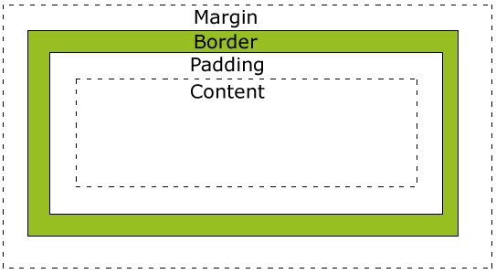
Block box model
div { width: 300px; padding: 25px; border: 25px solid navy; margin: 25px; }
div { width: 320px; padding: 10px; border: 5px solid gray; margin: 0; }

Slide 34
Block box model
Border
dotted , dashed, solid, double, groove, ridge, inset, outset
Outline
None of the border properties will have ANY effect unless the border-style property is set!
outline
p.one { border-style: solid; border-width: 5px;
border-color: #98bf21; } p.two { border-style: solid; border-width: medium; }
outline-color
p { border-top-style: dotted; border-right-style: solid; border-bottom-style: dotted; border-left-style: solid; }
outline-style
outline-width
The border-style property can have from one to four values.
border-style: dotted solid double dashed;
top border is dotted
right border is solid
bottom border is double
left border is dashed
border-style: dotted solid double;
top border is dotted
right and left borders are solid
bottom border is double
border-style: dotted solid;
top and bottom borders are dotted
right and left borders are solid
border-style: dotted;
all four borders are dotted
shorthand property.
p { border: 5px solid red; }

Slide 35
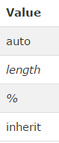
Block box model
Margin
Padding
p { margin-top: 100px; margin-bottom: 100px; margin-right: 150px; margin-left: 50px; }
p { padding-top: 25px; padding-right: 50px; padding-bottom: 25px; padding-left: 50px; }
margin: 25px 50px 75px 100px;
top margin is 25px
right margin is 50px
bottom margin is 75px
left margin is 100px
margin: 25px 50px 75px;
top margin is 25px
right and left margins are 50px
bottom margin is 75px
margin: 25px 50px;
top and bottom margins are 25px
right and left margins are 50px
margin: 25px;
all four margins are 25px
p { margin: 100px 50px; }
Short version works the same way
p { padding: 25px 50px; }

Slide 36
Block box model
Dimensions
Still affects the layout
Height
max-height
width
Visibility and display
Position like in a Cartesian , but inside its parent ex <div>
h1.hidden { visibility: hidden; }
Absolute Positioning
h1.hidden { display: none; }
Does nor affects the layout
Position
Relative Positioning
Static Positioning
Fixed Positioning
Overlapping Elements
li { display: inline; }
p.pos_fixed { position: fixed; top: 30px; right: 5px; }
Change an inline element to a line element used for navbars for example
img { position: absolute; left: 0px; top: 0px; z-index: -1; }
span { display: block; }
http://www.w3schools.com/css/css_positioning.asp

Slide 37
Block box model – float
1
2
.floating-box { float: left; width: 150px; height: 75px; margin: 10px; border: 3px solid #8AC007; }
IF float 3 to the left
3
4
It does not affect what is before only after
IF float 3 to the left
<div class = “floatright3”>
</div>
<div class = “floatleft4”>
</div>
The clear property specifies on which sides of an element floating elements are not allowed to float:
1
2
1
2
.div4 { clear: left; }
4
3
3
4

Slide 38
How to centre an element
1
.center { margin-left: auto; margin-right: auto; width: 70%; background-color: #b0e0e6; }
1
2
.right { position: absolute; right: 0px; width: 300px; background-color: #b0e0e6; }

Slide 39
Pseudo-classes
Go over list
http://www.w3schools.com/css/css_pseudo_classes.asp
Pseudo-elements
Go over list
http://www.w3schools.com/css/css_pseudo_elements.asp

Slide 40


Example of opacity
Images
http://www.w3schools.com/css/css_image_transparency.asp
img { opacity: 0.4; filter: alpha(opacity=40); /* For IE8 and earlier */ } img:hover { opacity: 1.0; filter: alpha(opacity=100); /* For IE8 and earlier */ }
#home a:hover { background: url('img_navsprites_hover.gif') 0 -45px; } #prev a:hover { background: url('img_navsprites_hover.gif') -47px -45px; } #next a:hover { background: url('img_navsprites_hover.gif') -91px -45px; }
Images Sprites
#home { width: 46px; height: 44px; background: url(img_navsprites.gif) 0 0; }

Slide 41
CSS [attribute] Selector
[attribute=value] Selector
[attribute~=value] Selector
[attribute|=value] Selector
[attribute^=value] Selector
[attribute$=value] Selector
[attribute*=value] Selector
Good for styling forms
CSS Attribute Selectors
a[target] { background-color: yellow; }
The following example selects all <a> elements with a target attribute:
a[target="_blank"] { background-color: yellow; }
<a> elements with a target="_blank" attribute
[title~="flower"] { border: 5px solid yellow; }
selects all elements with a title attribute that contains a space-separated list of words, one of which is "flower"
[class|="top"] { background: yellow; }
either alone, like class="top", or followed by a hyphen( - ), like class="top-text"! --- if ^ then can be just starting with top like topsomething
[class^="top"] { background: yellow; }
[class$="test"] { background: yellow; }
all elements with a class attribute value that ends with "test"
[class*="te"] { background: yellow; }
selects all elements with a class attribute value that contains "te"

Slide 42
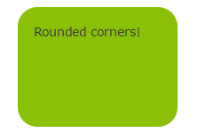
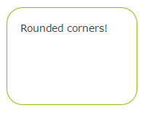
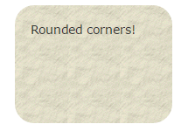
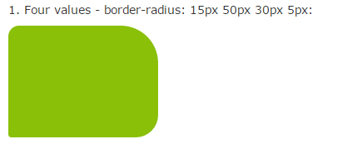
Css3 – cool and new
Background
Border
Background image
#rcorners1 { border-radius: 25px; background: #8AC007; padding: 20px; width: 200px; height: 150px; }
#rcorners2 { border-radius: 25px; border: 2px solid #8AC007; padding: 20px; width: 200px; height: 150px; }
#rcorners3 { border-radius: 25px; background: url(paper.gif); background-position: left top; background-repeat: repeat; padding: 20px; width: 200px; height: 150px; }
border-top-left-radius

Slide 43
Background image
http://www.w3schools.com/css/css3_backgrounds.asp

Slide 44

Gradients
To go from one colour to the other
background: linear-gradient(direction, color-stop1, color-stop2, ...);
#grad { background: -webkit-linear-gradient(red, blue); /* For Safari 5.1 to 6.0 */ background: -o-linear-gradient(red, blue); /* For Opera 11.1 to 12.0 */ background: -moz-linear-gradient(red, blue); /* For Firefox 3.6 to 15 */ background: linear-gradient(red, blue); /* Standard syntax */ }

Slide 45
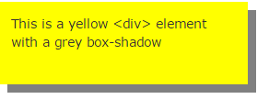
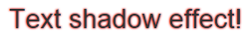
Shadows
h1 { text-shadow: 0 0 3px #FF0000; }
div { box-shadow: 10px 10px grey; }

Slide 46
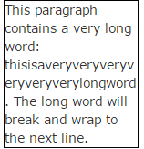
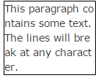
Some other text options
text-overflow
word-wrap
word-break

Slide 47
Put different fonts
@font-face { font-family: myFirstFont; src: url(sansation_light.woff); } div { font-family: myFirstFont; }

Slide 48
Animaitons on css
Go to the w3s
And open the examples
http://www.w3schools.com/css/css3_2dtransforms.asp
http://www.w3schools.com/css/css3_animations.asp

Slide 49
Dom

Slide 50
Github course
Git commands
Git status
Git init : to create a new git repository
Git add file_name : for staging – git add --all to add all the files
Git Commit –m “this is the new index” – to make the changes m is the message
Git log : show the commits of a path
Git log --graph --decorate --all --pretty=oneline – see commits as a tree
Git checkout identificationumber : to go back in time to a commit
Git checkout branchnmae to go to other branch
Git branch name – to create a new branch
git config --global user.name "Your Name“
git config --global user.email "your_email@whatever.com"
Git push data form local to online
Install and open git bash – this is a linux mashine
Commands
Pwd – to see position folder
Ls = “list” to see the list of all the files in a folder
Ls – a includes the hiddent files
cd – to go to a new repository – example ( the space is important -- cd /c/
Cd users/ will send to the folder users inside c
Clear – to clean the linux terminal
Mkdir nameofdirectory – to make a new directory
rm -r directory_name - to remove a directory
Rm remove file – example rm test.txt
cd.. Is go up one level
Git = to make sure git is there
Shift + q to exit a end in the terminal
https://www.youtube.com/watch?v=0fKg7e37bQE
http://rogerdudler.github.io/git-guide/
https://www.youtube.com/watch?v=DVDLoe_2MBc
https://www.youtube.com/watch?v=61WbzS9XMwk

Slide 51
git
1
2
3
Create a repository
Comand: git init
Staging
Put thing ready to be commited
Git add intex.html
Commit
Put thing ready to be commited
Git add intex.html

Slide 52
github
1
2
3
Create a repository
Create an account and go to the plus and create a online repository
Push changes
Put commited
Into git
Git push
Keep updted
Bring to your local what other team members have changed
Git pull
Connect the local repository with the github
git remote add origin https://github.com/flibijuan/shoppinglist.git
git push -u origin master

Slide 53
Git hub – conflict resolution
1
2
3
When pushing – github is going to ask for a pull first
Push changes
And git will answer this is an error and is going to enter into a merging mode
Solve the problem
Go to the editor look at the problem and then adter is fxied by hand
Git status
Git add –all
Git commit (without a message)
Then to tell it to continue press :wq or if it is a separate window just close it
Git push to make the changes

Slide 54
For other team members to connect to my project
1
2
3
Clone the online project into your computer
Push changes
Put commited
Into git
Git push
Keep updted
Bring to your local what other team members have changed
Git pull
Git clone url-of the project

Slide 55
Add colaborators
Project owner
Settings
Colaborators
Add friend

Slide 56
bootstrap
There are two container classes to choose from:
The .container class provides a responsive fixed width container
The .container-fluid class provides a full width container, spanning the entire width of the viewport
https://www.youtube.com/watch?v=2W03ZymI46g

Slide 57
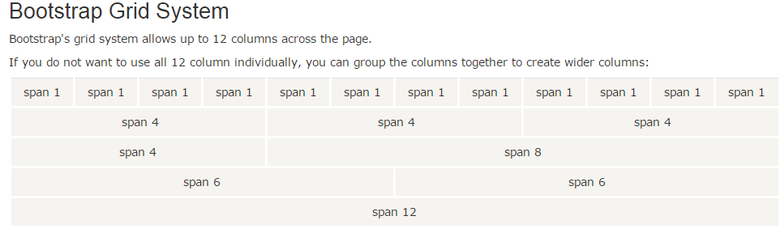
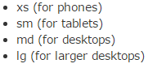
This is what makes the magic of the responsive design
First use a class row and then class Colum, the sum of the columns need to be 12
Push
Pull
To change the order of the greed in mobile or in web
<div class="row"> <div class="col-sm-4">.col-sm-4</div> <div class="col-sm-4">.col-sm-4</div> <div class="col-sm-4">.col-sm-4</div> </div>

Slide 58

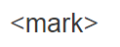
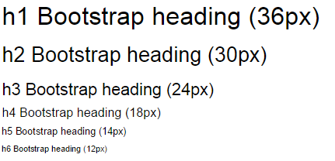
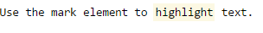
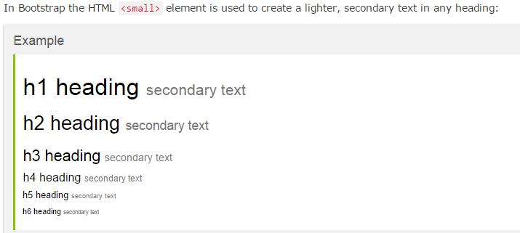
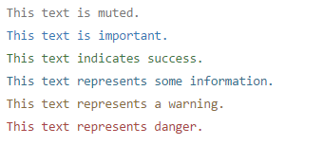
.text-muted, .text-primary, .text-success, .text-info, .text-warning, and .text-danger

Slide 59
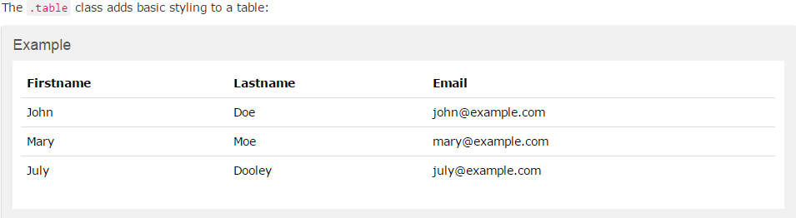
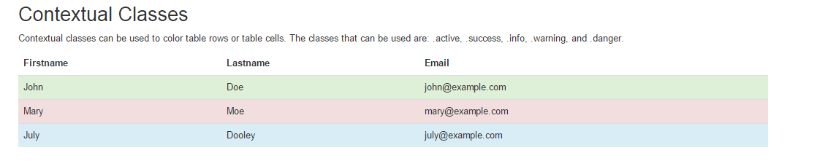
Bootstrap Basic Table
.table-striped
.table-bordered
.table-hover
.table-condensed
.active | Applies the hover color to the table row or table cell
.success | Indicates a successful or positive action
.info | Indicates a neutral informative change or action
.warning | Indicates a warning that might need attention
.danger | Indicates a dangerous or potentially negative action

Slide 60
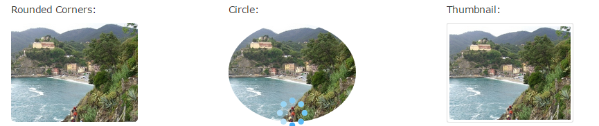
Image management
<img src="cinqueterre.jpg" class="img-rounded" alt="Cinque Terre" width="304" height="236">
We have to add class = “image responsive” to the img tag to make it responsive
<img src="cinqueterre.jpg" class="img-circle" alt="Cinque Terre" width="304" height="236">
<img src="cinqueterre.jpg" class="img-thumbnail" alt="Cinque Terre" width="304" height="236">

Slide 61

To scale up or down images or videos
<!-- 16:9 aspect ratio --> <div class="embed-responsive embed-responsive-16by9"> <iframe class="embed-responsive-item" src="..."></iframe> </div> <!-- 4:3 aspect ratio --> <div class="embed-responsive embed-responsive-4by3"> <iframe class="embed-responsive-item" src="..."></iframe> </div>

Slide 62
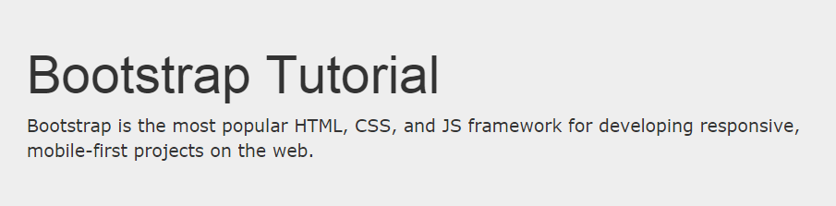
Bootstrap Jumbotron and Page Header
We first create a container class so that the jumbotron take the same dimensions , if we would like it to be full screen , then we put it out
<div class="container"> <div class="jumbotron"> <h1>Bootstrap Tutorial</h1> <p>Bootstrap is the most popular HTML, CSS, and JS framework for developing responsive, mobile-first projects on the web.</p> </div> <p>This is some text.</p> <p>This is another text.</p> </div>
<div class="page-header"> <h1>Example Page Header</h1> </div>

Slide 63
<div class="well well-sm">Small Well</div> <div class="well well-lg">Large Well</div>
Small or large

Slide 64
Alerts
.alert-success, .alert-info, .alert-warning or .alert-danger:
<div class="alert alert-success"> <strong>Success!</strong> Indicates a successful or positive action. </div>

Slide 65
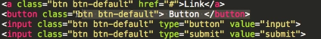
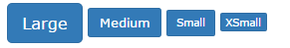
Button class
There are 4 ways to create a button
.btn-lg
.btn-md
.btn-sm
.btn-xs
The button classes can be used on an <a>, <button>, or <input> element:
<button type="button" class="btn btn-default">Default</button> <button type="button" class="btn btn-primary">Primary</button> <button type="button" class="btn btn-success">Success</button> <button type="button" class="btn btn-info">Info</button> <button type="button" class="btn btn-warning">Warning</button> <button type="button" class="btn btn-danger">Danger</button> <button type="button" class="btn btn-link">Link</button>
The class .active makes a button appear pressed, and the class .disabled makes a button unclickable:
Add class .btn-block to create a block level button:

Slide 66
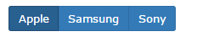
Button groups
http://www.w3schools.com/bootstrap/bootstrap_button_groups.asp
Go to linck
.btn-group-vertical
To make a group create a div and then put the buttons inside
.btn-group-large example
.btn-group-*
<div class="btn-group"> <button type="button" class="btn btn-primary">Apple</button> <button type="button" class="btn btn-primary">Samsung</button> <button type="button" class="btn btn-primary">Sony</button> </div>

Slide 67
Glyphicons
<span class="glyphicon glyphicon-name"></span>
Insertion of a glyphicon
http://www.w3schools.com/bootstrap/bootstrap_ref_comp_glyphs.asp

Slide 68
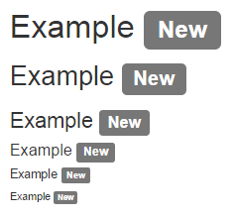
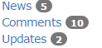
Badge and label
<a href="#">News <span class="badge">5</span></a><br> <a href="#">Comments <span class="badge">10</span></a><br> <a href="#">Updates <span class="badge">2</span></a>
<h1>Example <span class="label label-default">New</span></h1> <h2>Example <span class="label label-default">New</span></h2>
Use span to add this badge to a link
.label-default, .label-primary, .label-success, .label-info,.label-warning or .label-danger, within a <span> element to create a label

Slide 69
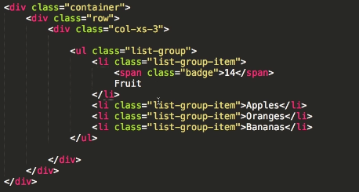
List group
Try to make disable and active

Slide 70
logo
home
About
Programs
c
Become a business leader with the skills to deploy your ideas through technology
2 img
Learn from experts in entrepreneurship and IT to manage and code web and mobile projects in only 2 months by using meteor.js
The best way to learn coding for the business lieder of tomorrow
Make young innovators ready to drive change with the latest IT tools.
Be the place where the business and the IT world find each other to enhance creative processes
Codementor gives you a key differentiation factor and makes you a professional with a very scarce and highly demanded profile. That can either target to apply for a high position in the corporate world or be a valuable asset in a startup team.
Codementor enables students and young professionals with a business background to execute ideas, manage teams and assess projects with a strong IT component.
We want to provide fast, business-geared learning at the right price.

Slide 71
logo
home
About
Programs
The course have a methodology divided into 3 fundamental pillars
Coding training 80%
IT workflow
Business consulting
We will guide you through a process in which you will first master the basics of front-end development (HTML, CSS and JavaScript), to quickly move to back-end development (Meteor) which is the main focus of the course. You will be able to create web or mobile projects in a prototype version (iOS & Android) from the user interface to the management of the databases and user accounts.
We train you in how to manage the IT workflow and the IT management tools, you will learn to use Github, best practices of slack, mailchimp, mamp, wamp and ftp servers like cyberduck among other common tools that are indispensable to entrepreneurs nowdays
Because your ideas matter to us, the program includes a design thinking activity and a session of personal or group business&IT consulting/mentoring to help you understand market and technical feasibility of your ideas
http://media5.cdn.builtinaustin.com/sites/www.builtinaustin.com/files/imagecache/Original/images/shutterstock_189811220_0.jpg

Slide 72
logo
home
About
Programs
Customizable program
We provide 3 options of classes for you to have the flexibility and the environment you need
At codementor you can choose to take individual classes completely flexible to your needs, group classes 3 times a week or subscribe as a group and share this educational experience with your friends
Connects to programs section
I had a background in marketing and a masters in innovation and strategic management, and know with codementor i can go to job interviews with a very complete profile and show that I have very strong soft and technical skills, I became a very attractive candidate for companies with a innovative mindset
Evert
LN
I am an engineer with a masters in business and codementor helped me to complete the set of skills I needed to give it a try to entrepreneurship.
Michael
LN

Slide 73
logo
home
About
Programs
I learn not only how to code but how a lot about the technology industry and how to relate with developers in order to effectively manage a startup project
Sofien
LN
Coding is the skill with the highest demand and to be a business person with this skill opened my mind to think about a hole new set of business models with a focus on disruptive innovation.
Robin
LN
Contact information
Google map … showing solvay
Footer

Slide 74
logo
home
About
Programs
Map of solvay
If you need to contact us please refer to the following email or you can call us to 0032485646801
Codemendtor is a small team based in Brussels specialize in coding and entrepreneurship with the support of Solvay business school of economics and management, created a course meant for business students to be able to use all the tools (with a strong focus on Meteor.js) they need to start your own start-up.
The subscription to any of the courses is through direct contact – please contact us directly to bla or call us to 0485646801
Partners -- solvay
Solvay

Slide 75
logo
home
About
Programs
We provide 3 options of classes for you to have the flexibility and the environment you need
icon
icon
icon
Subscribe for private coaching! In this option we will assign a person who will act as personal professor and coach. The amount of classes and hours per week can be personalized.
A group of friends (from 3 to 8) can decide to subscribe together as a group. This is our most recommended option because friends support each other, co-work easily and who knows, maybe at the end of the program can start a venture together! The classes can be set at the most convenient time for all the team.
If you subscribe to a group class you will go through the program with other motivated people and work together. This is a course that will require 9 hours of class plus 9 hours of outside class work.
All the programs include
Starting from
250 euros month
Contact us
To subscribe to any of the courses – please contact us directly to bla or call us to 0485646801
Notes:
Open group to solve any kind of questions (slack)
Meteor and JavaScript digital books
2 project themes to get started
Design-thinking activity
Both Windows and iOS
Responsive web design
Physical classes
Business mentoring

Slide 76
logo
home
About
Programs
All our programs follow the following methodology, which is divided into 3 fundamental pilars , trying to teach you how to code not only from the logic of the code but only from the workflow and the business side
Coding training 80%
IT workflow
Business consulting
We will guide you through a process in which you will first master the basics of front-end development (HTML, CSS and JavaScript), to quickly move to back-end development (Meteor) which is the main focus of the course. You will be able to create web or mobile projects in a prototype version (iOS & Android) from the user interface to the management of the databases and user accounts.
We train you in how to manage the IT workflow and the IT management tools, you will learn to use Github, best practices of slack, mailchimp, mamp, wamp and ftp servers like cyberduck among other common tools that are indispensable to entrepreneurs nowdays
Because your ideas matter to us, the program includes a design thinking activity and a session of personal or group business&IT consulting/mentoring to help you understand market and technical feasibility of your ideas
http://media5.cdn.builtinaustin.com/sites/www.builtinaustin.com/files/imagecache/Original/images/shutterstock_189811220_0.jpg
Notes:
Open group to solve any kind of questions (slack)
Meteor and JavaScript digital books
2 project themes to get started
Design-thinking activity
Both Windows and iOS
Responsive web design
Physical classes
Business mentoring

Slide 77
Day 1 | day2 | day3 | day4 | day5 | day6
Html
Digital technologies are driving the innovation of the world, and in booth the entrepreneur world and the corporate world the need of leaders with the skills to materialize ideas with web mobile app or any kind of IT solutions are more valuable in the market. And this is exactly what codementor gives you
Codementor gives your business profile a key differentiation factor and makes you a professional with a very scares and highly demanded profile. That can either target to apply for a high position in the corporate world or be a valuable asset in a startup team.

Slide 79
Contain wherever you want
Information we are holfing (called enviroment) , variables, things like mouse and keyboard imput are already part of the program at the beginning
Array (list)
Functions
Var
Objects
6 Types of values :
Numbers(2.3)
Strings “I am awesome”
Booleans
Objects
Functions
Undefined values
Variables:
Methods
(functions)
Var
Null undefined
Console.log()
Screan

Slide 80
Example
Add a friend
Class users ~~~~ object family
log-in
Object user1
User1.addfriend (michael)
Making use of a function that we assume already exist
What the function is going to use to execute
function Addfriend (user) {
Put the name into an array of names
};

Slide 81
Numeric var or text
var something = somethingElse
Function
Notes:
https://www.discovermeteor.com/blog/javascript-for-meteor/

Slide 82
strings
If you put quotes it becomes a string
Proeprties
“this is a string”
‘\n’ – new line
‘\t ‘ - give a tab character
‘\\’ - backslash
Concatenate
“I” + “am” + “awesome”

Slide 83
Operators
Binary
Unary
Logic
Ternary
+ * % /
-
Typeof
delete
!
+=
*=
-=
++
_ _
&& //and
|| //Or
! //Not
Boolean ? entery1 : entrey2
>=, <=
The it returns entry one if it is false it returns entry 2
=
==
===
If this is true
Unary operator that flips the value given to it in booleans
!=
!==
1 + 1 == 2 && 10 *10 > 50
in

Slide 84
Boolean
True or false
Example
3 == 3
3>1
3<1
“t” == “t”
NaN === NaN // false
Console.log (true && flase) //false
Console.log(true && true) //flase
!true // false

Slide 85
Our first program
1;
!false;
But this would just despaired , it is not affecting the world , do how do we save information
Variables
Var name = 5 *5 ;
After creating it the name of the variable can be used as an expression
This is a reserved word

Slide 86
Keywords and reserved words

Slide 87
Function
A function is a peace of program wrapped in a value , that can be applied in order to run the wrapped program
Thik about the functions in exel , they they do something , the only thing you need is to put the arguments
Alert(‘text’);
isNaN();
Console.log(math.max ( 2 , 4 ));
Confirm (“do you like this”) ;
Prompt (‘tell me what you think’);
Exersice – create the max function

Slide 88
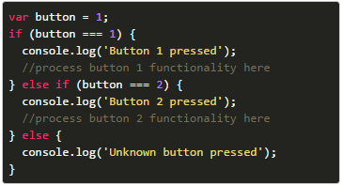
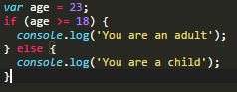
Conditional execution

Slide 89
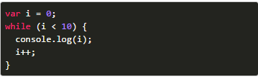
While do loops
It’s a control structue , always execute its code atleast ones
Do {
var name = prompt(“who are you”); }
While (!name);

Slide 90
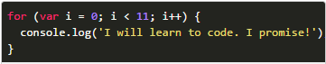
For loops
It stops the cycle

Slide 91
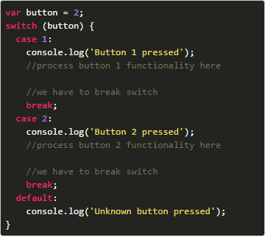
Value switch
Small exersice with prompt

Slide 93
functions
Functions declaration are not part of the regular top-to-bottom flow of control. They are conceptually moved to the top of their scope.
Js is flexible with the amount of argument
In javaScript functions are the only program that creates a new scope/ local enviroment inside its {}
Defining a function
var name = function(x , y) { return x * y; }
Do not declare the functions inside a logic element , just on the main block or inside other function
Simplified declaration
If a var is created inside is a local var and not global
function name(x) { return x * x ; }
Notes:
You can use functions as, control flow and even create function inside functions

Slide 94
Functions – closure

Slide 95
Function recursion
Notes:
More elegante , sometime easy to find solutions but is slower

Slide 96
functions
Side effects
Return value

Slide 97
How to access a property and a method
value.dotnotation
value[bracknotation]
The difference is in how x is interpreted
It needs to be a directly variable name
Only accepts variables names
Evaluated to get the property name
If there is an indexation or calculation it will calculate it first and then the result will be the property name
Value.lenght
Value.[i]
Array.lenght
Array[“length”]

Slide 98
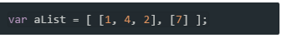
Array – list
You can put integer, float , Boolean, arrays, functions and objects
Declaration
2
Var array = ["Saab", "Volvo", "BMW"];
aList[0]
Array Properties and Methods
var cars = new Array("Saab", "Volvo", "BMW");
.length;
.push(“newEelement"); or unshift to add at the beggining
.join(“ “)
.pop .shift // delete the last or first element and returns it
fruits[fruits.length] = "Lemon";
.splice(from number , to numner)
.indexof(something) //look the # index where that content is (you can also use lastindexof
.foreach(function());
.filter()
In JavaScript, arrays use numbered indexes.
In JavaScript, objects use named indexes.
Access de element of an array
Cars[xposition];
Cars[xposition] = “change the content”;
Amount of options to declare
Notes:
Exercise looking an array

Slide 99
Objects
2
var object = {
Properties
Methods
};
Call an object property and methods
Object
Object.property;
Object.function();
object = new Object();
Property
Methods
2
2
{Name: “juan”,
Age: 23 }
methodName : function() { code lines
};
objec.name = “juan”;
Object.age = 23;
Object.methodName = function() {
Code lines
};
This is hoe to Add property ones the object is already created
This is how to Add Methods ones the object is already created
Amount of options to declare

Slide 100
Mutability
Var 3
Object content
false
Object content
Var 1
Var 2
True

Slide 101
Looping objects
The is what makes it work
A local variable used during the for to iterate all the properties
Object name

Slide 102
Exersices(3)
1 create a function with 2 arguments to give any new property with any new value to an object.
create 50 objects (persons) with 4 characteristics (name, family_name, date) but all the information inside them different and a array with 10 entrees about the favorite numbers of the person.
The put all the objects in an array then in an array
Then create a function that you can give a number and it will tell you the names of all the people that like that number
Reverse the order of an array of 100 elements

Slide 103
The arguments object
It’s a temporary object that its created when a faction runs to contain all the arguments needed in that function.

Slide 104
Math object

Slide 105
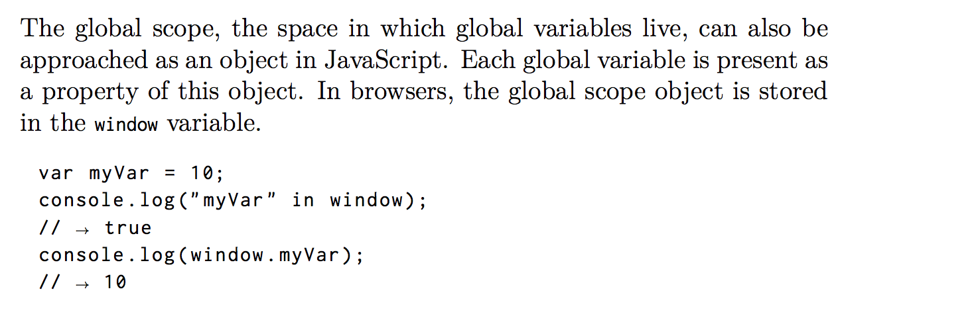
The global object

Slide 106
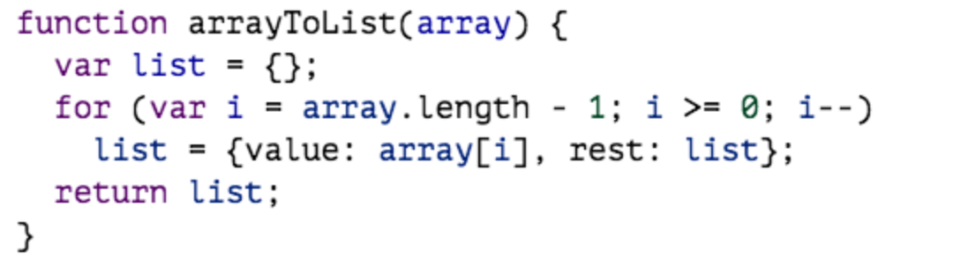
Example form array to list

Slide 107
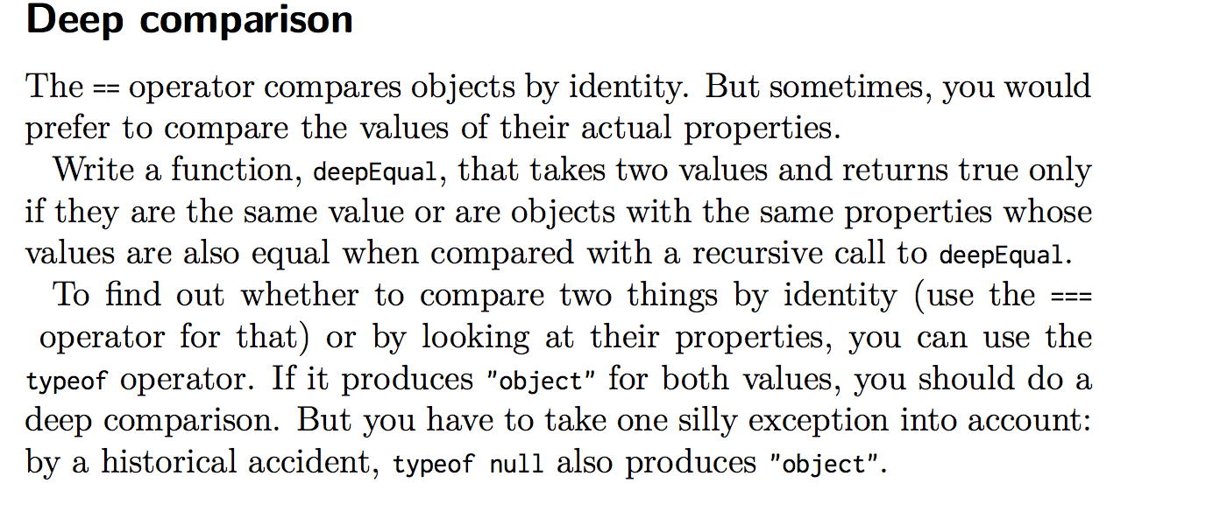

Slide 108
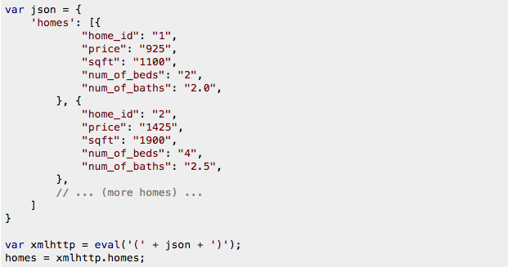
JSON
Special type of notation used to store data
JSON.stringify(the jason file)
JSON.parse(file)

Slide 109
Array.map
https://www.youtube.com/watch?v=t4MOEfpsC60
Very usefull to find a list of something from a JSON , example return item.age
var kvArray = [{key:1, value:10}, {key:2, value:20}, {key:3, value: 30}];
var reformattedArray = kvArray.map(function(obj){
var rObj = {}; rObj[obj.key] = obj.value; return rObj;
});
// reformattedArray is now [{1:10}, {2:20}, {3:30}], // kvArray is still [{key:1, value:10}, {key:2, value:20}, {key:3, value: 30}]
Item
Condition : the resulting array have the same amount of entries that the initial one

Slide 110
Array.filter -- array.reduce
https://www.youtube.com/watch?v=t4MOEfpsC60
The individual thing that I will be looking on
The hall thing , what I want to return , number, array or object

Slide 111
JSON reduce
The individual thing that I will be looking on
The hall thing , what I want to return , number, array or object
[] , {} , {male : [] , female: []}
all.push(item.age);
All[item.name] = item.age;
All[item.gender].pish(item)

Slide 112
Blocks
{
statement_1;
statement_2;
...
statement_n;
}

Slide 113
Reduce exersice
Get the maximun age
Get all the names
Get all the ages
Get the longest name

Slide 114
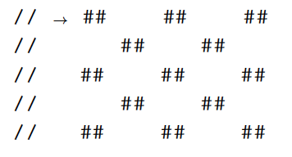
exersice

Slide 115
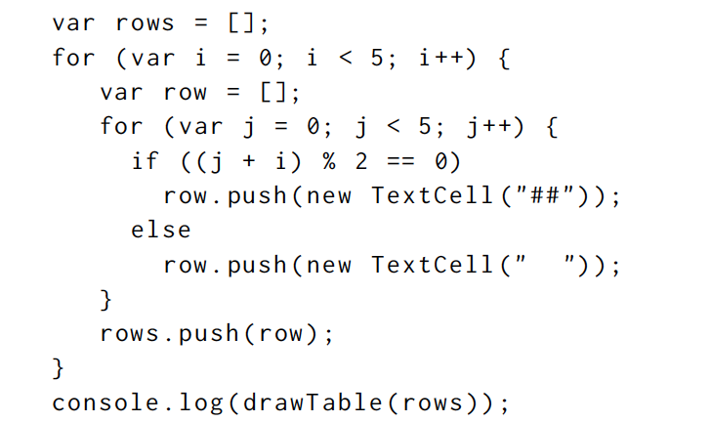
exersice

Slide 116
Bind method of all functions
Calls a function but with some of its arguments already set
Getready.bind(null, the set);

Slide 117
Every and some on array
Arr.every(functionname);

Slide 118
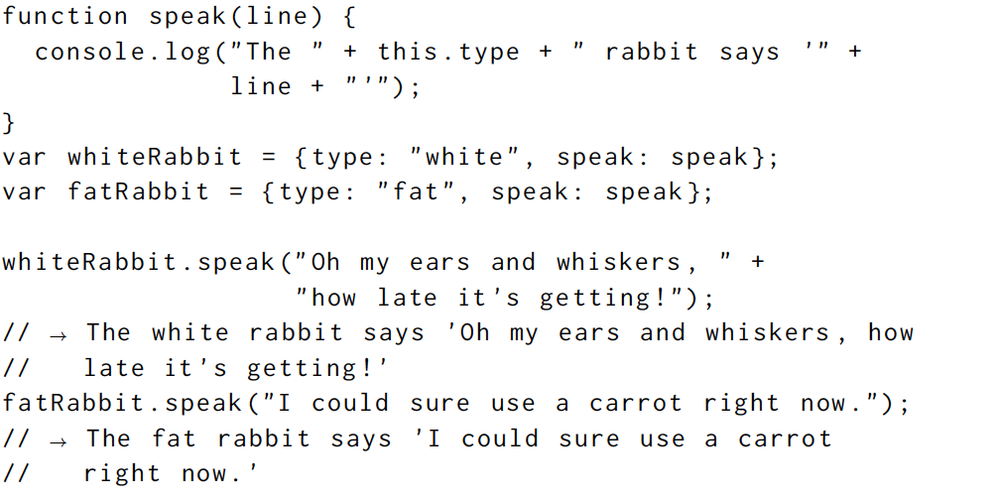
https://www.youtube.com/watch?v=su-SdgebJCE
The object that owns the method
THIS

Slide 119
Prototype object
Is another object that that is used as a fallback source of properties
The prototype
Array.prorotype;
Object.prorotype;
Function.prorotype;
Object.getPrototypeOf({}) === Object.prototype;
Object.getPrototypeOf(somefunction like isNaN) === Object.prototype;
Object from a constructor 1= country
Object.getPrototypeOf([]) === Object.prototype;
Object city
Object.getPrototypeOf({})

Slide 120
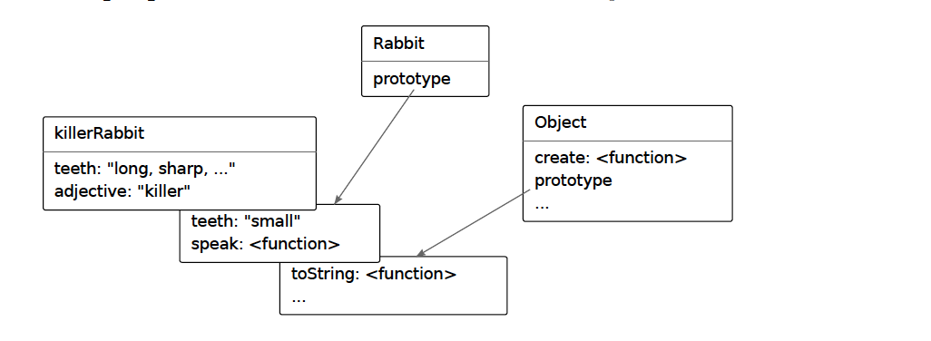



Constructor function
Exercise make countries and cities
https://www.youtube.com/watch?v=bstIvkeksAk
Same way that a function put variables are created inside
Notes:
Exercise is to create a new object type
Create 5 objects of this type
Then look at the objects prototype on the console
Create a new object that depends from the other prototype
Add a new function to the first prototype
Use the function with one of the objects of the second prototype

Slide 121



Properties of the prototype
Numerable
Non numerable
The ones we create inside the constructor
Use (var bla in object) to see if it finds it and use for(var a in object) and print properties

Slide 122

Create a object without prototype
The object comes with a prototype
The object doesn’t comes with a prototype
Notes:
Map
blocks

Slide 123


Getters an setters
Used for creating methods that work but other developers cant overwrite them
Get also possible

Slide 124

Inheritance --- is a good trick but not he best way
City.prototype = country; // prototypeName to create iinheritance from
Prototypes can have prototypes

Slide 125
BUGS AND ERROR HANDLING

Slide 126

Strict mode

Slide 127

Debugging
https://www.youtube.com/watch?v=-q1z8BPFItw
Make a code to test your code on all the possibilities
run
Add a watch
Run per line
Add a variable to follow during the process
Using brack point in developer tools --- you can find it on sources
Standard
Conditional
Include a debugger element in your code

Slide 128
Console.log console.clear

Slide 129

Throw , try , catch and finally

Slide 130



Regular expression
Especial object that can act as string but has other properties
If we want to represent a symbol string in regular expressions like + or – we have to put a \+ … this is for every character that is nor a letter number or white space
Methods
Is there anything in the string that follow this reg expression pattern

Slide 131



Regular expression
Means that the length of the string is one or more numbers
https://www.youtube.com/watch?v=44P2s6bZ8Js
\d+
\d*
Same than + but from cero
Match any character expect the ones in the set
[^\d]
\d?
It can or not match the character
\d{x} \d{x,z}
The digit have to be repited x time or from x to z
Capital letters
//i
Case insensitive
(haa)+
() group an expresion
\b
Space between words
$ Match any string with \d at the end of it and ^ at the bigining
\d$ -- ^\d

Slide 132

Reg expresion – exec
Regexp.exec(sting); ---- is the same that test but return null if doesn't’t find anything or an object with information

Slide 133

Regular expression – exercise
Make a regular expression so that this test is true
example

Slide 134


Date type
Java script has a predefined object to use for dates
Date.getFullYear
Date.getYear
Date.getMonth
Date.getDate
Date.getHours
Date.getMinutes
Date.getSeconds
Date.now
Date.getTime()
To get the convention of milliseconds count

Slide 135


Choice pattern

Slide 136



Replace method
This is possible in strings ,, but we can also put a regular expression and use a g (global to make something more general)
Replace for the match of the second group .. Round marethesis
Global matching -- always return an array
The ? Makes the term nongreedy making it match each small coment and not all

Slide 137


Dynamically creating Regular expressions
Replace for everything that was found

Slide 138

Regular expressions , search
Gives the girst index of on which the expression was found or -1 when it wasn’t found

Slide 139
MODULES
Namespacing
Reuse
Libraries
NPM
https://www.youtube.com/watch?v=pa4dc480Apo
Decoupling
Using Function as name space
Objects as interfaces

Slide 140
Modules
If you make a structure from the beginning you will finish locking you self into a structure that actually does not fit the program
Page 1
Start just putting everything together
Code
Code
Code
Code
Code
Ones is obvious that something can start to be group
Split that part of code in a new file and work on it

Slide 141

Functions as name space
Prevents that anything is global variable
Is JavaScript if an expression starts with the keyword function , it is a function expression, if a statement starts with function, it is function declaration, which requires a name and not being and expression
The () is a trick to force the function to be interpreted as an expression

Slide 142
Objects as interfaces
Function
Create object
Code method
Code property
Code
Code
Return object that contains all the methods and classes that are in the module
Object in general is called exports d
Module

Slide 143
Detaching from the global scope
We are going to create a system that allows one module to directly ask for the interface object of another module, without going through the global scope.
We are going to use a require function that, when given a module name, will load that modules file (from disk or web)and return the appropriate interface value
1
2
Create a function readFile
Execute this string as a JavaAcript code
Lets pretend we have this function and that what it does is: return the content of a given file as a string

Slide 144
AND THE BROWSER

Slide 145

Networks protocols – email, messages , files
https://www.youtube.com/watch?v=F27PLin3TV0
https://www.youtube.com/watch?v=4IMc3CaMhyY
Transmission control protocol(TCP)
All internet connected devices speak it and most communications on the internet is built on top of it
HTTP – hypertext transfer protocol
HTTPS – encrypted protocol
Used to connect to the internet
Request documents over the network
URL – Universal resource locator
Every document on the web has a unique one

Slide 146
+

Slide 147
<script>
<script src = “”></script>

Slide 148

DOM --- Document object model
The browser creates a model and then represents this model on the website
Is a live data structure
The browser interprets each box as an object , that we can ask for information like what tags are inside (interact with)
Properties of the document object
documentElement --- it point to the <html> tag
head -- Hold the object for the body element
body -- Hold the object for the head element
The variable document give us access to this object

Slide 149

The DOM is a tree and the document. documentElement is the root
Each node has a nodeType property
1
Standar elements
2
Text
8
Coments
document.ELEMENT_NODE
document.TEXT_NODE
document.COMMET_NODE

Slide 150
Each node has a property
parentNode
firstChild,
childNodes, -→ points to an array-like object of all the child elements
lastChild
nextSibling
PreviousSibiling
Code that interacts a lot with the DOM tends to become long,repetitive and ugly

Slide 151

Use of a recursive function to look for a string node with a specific text through all the DOM
text

Slide 152

Finding a specific element (3 ways)
Get are live arrays
1
It collects all the elements with the given tag name that are descendants (direct or indirect children) of the given node and return them as an array-like object
To find something more specific we can set an id to an element
2
And then use this property ..
Here we can also use getEelementByClassName
3

Slide 153

Changing the document
.removeChild
.appendChild → puts it at the end of the list of children
.insertBefore(nNew,n2) → insert node give as the first argument .before the node given as the second argument
.replaceChild(nNew,n2) → replace one child node with other one , the replaced node should be a child of the node that calles the property
Nodes can only exist one time (because is a tree), therefore if an node has a position already when inserting it to other position it will be deleted form it current one

Slide 154
Creating nodes
<!DOCTYPE html>
<html>
<body>
<p>Click the button to create a Text Node.</p>
<button onclick="myFunction()">Try it</button>
Here is creaitng the text elements
<script>function myFunction() {
var t = document.createTextNode("Hello World"); document.body.appendChild(t);
}
</script>
</body>
</html>

Slide 155
Creating nodes
<!DOCTYPE html>
<html>
<body>
<p>Click the button to create a h1 element with some text.</p>
<button onclick="myFunction()">Try it</button>
<script>
function myFunction() {
var h = document.createElement("H1");
var t = document.createTextNode("Hello World");
h.appendChild(t);
document.body.appendChild(h);
}
</script>
</body>
</html>

Slide 156



Creating nodes
If we don’t want an live array but a solid one
This is what changes a node ofr otherone
We have to start form the last node of the array because the array is live and at any change in the code it would dynamically change

Slide 157


Access the attributes
.getAttribute
.setAttribute(“atributename”, “atributeresult”)
We can make our own pre-made attributes to and put strings or numbers on them to that we can use them as a verification to change things in the DOM
Some attributes like href can be access by a DOM property
On the other hand you can set any attribute you want on nodes using

Slide 158

Access the attributes – the Highlighter example
The note we want to change
Regular expression
Returns a string
Exec is a function that search in the text argument for a keyword in general used with regular expressions, it returns an array, if it doesn't’t find it returns null

Slide 159

Access the attributes – the Highlighter example
It returns the string value contain by the attribute
If a javascript object has a property with a name x

Slide 160

Speed of the DOM
to calculate the time
LETS MAKE A LIKE OF X WITH JAVASCRIPT OF A 2000 PX LENGTH
1
XXXXXXXXXXXXXXXXXXXXXXXXXXXXXXX
The with of the span element on the website
Option one refreshes the view a lot of times till it gets to the expected with and option two makes calculation and then affects less times the DOM
2

Slide 161

DOM STYLING
JavaScript can manipulate the style of elements throgt the the node’s style property
Display: block
Display: none
Display: inline
Changes the value of the property
If the style name has a – like font-family we have to use style[“font-family”] or style.fontFamily instead of style.font-family

Slide 162
DOM with the CSS page
More specific has more power
CCS herarqui
Inline style = “x:x”
P.c#b {}, p a{} p>a
css page - p {
X:X;
X:x;
}
P.a{}
Prestablish style
P{}

Slide 163

Query selectors
Document.querySelectorAll
Document.body.quierySelectorAll
Query are not live arrays
Search for nodes by the selector
If we take it away then it only get the first element

Slide 164

Positioning and animating
1
2
3
4
6
Get the node to animate
Var for new Date and to store the movement
Create a function stores += the difference on the time on the counter
Set the attribute top or left to the node with position relative.
Use requestanimationframe (function) to loop for the animation
Position style property
Position: static – by default for all elements
If we change it to relative element still take space in the document but now we can get access to the top and left properties.
Top-left are used to absolutely position it relative to the top-left corner of the nearest enclosing element that has a position:static
This is the loop, it schedules de animation function to run whenever the browser is ready to repaint the screen

Slide 165


Event handler
This are functions as handlers for specific events
Every Nod of the DOM has a event Listener and allows to listen specific on that element, so that is not a global click but a element click

Slide 166

Event object and propagation
The event are objects and have properties the most important one
Which and target return a number\
Which:
1 for left click
2 middle click
3 right click
Target: returns the node that started the event
This is the event capture by the listener

Slide 167
Event object and propagation
First event that takes the event handle and then the second object if it also has a event handler would be activated
click

Slide 168

Event object and propagation

Slide 169

Event target attribute
Name of the html element, always in capital letters
Returns a node

Slide 170

Key event
The key event attribute KeyCode help us to know what was the key that was pressed

Slide 171


Key event
To know what key was pressed
To know what text was generated

Slide 172


Mouse event
Mousedown and mouseup
dblclick
It Give us the coordinate of the place where the user lick the mouse

Slide 173


Mouse motion
The position of that click inside the node
If it is a left click
Find the node to manipulate
We add an event listener to know if the person click over the node
Prevent that the mouse creates a selection box

Slide 174


Scroll event
Get the element
Scrollable height
Height of the window
returns the pixels the current document has been scrolled from the upper left
Get the element

Slide 175


This event does not propagate
Focus event
Exit the focus
The focus event

Slide 176


Load event
This event does not propagate
When a document finish loading a a “load” and “beforeunload”
Script execution timeline
The worker , is a second JavaScript that runs on parallel to the main one

Slide 177



Setting Timers
Example a function that change color of background after some seconds
Could be also setInterval
Could be also clearInterval

Slide 178

Setting Timers

Slide 179

Debouncing
Group event triggers with the timeout function to prevent that the page is crazily overload

Slide 180

Debouncing

Slide 181


Slide 182

2
Save in array all the static element
1
Level Constructor
6
Go throw all the elements of the array using a double loop and store them in an array with corresponding name (lava, wall or space) and then put in a different array dynamic objects
3
Printing elements using the DOM
Save in array all the dynamic elements
4
5
Create a prototype for the and the object for each type of dynamic element
Add event listeners and Give all the properties and methods to those object so that they can move

Slide 183
The game exercise
Adjust run game to create lives have the player start with 3
Create a pause and continue --- for it wrap the runlevel function into a event listener that makes the animation stop when user press the key control

Slide 184
Drawing a canvas
Is like a html DOM used for describing object that focus on shapes rather than text. An is possible to embed a SVG document in a html document
SVG
Canvas
or it can be included with an image tag called (canvas)
The main difference between a canvas and an SVG picture is that is SVG the original description of the shapes is preserved so that they can be moved or resized at any time. A canvas on the other hand , converts the shapes to pixels as soon as they are drown and does not remember what these pixels represent. The only way to move a shape on canvas is to clear the canvas and redraw it with the shape in a new position

Slide 185


The SVG element
Starts the svg mode
Inside svg we can use hole new set of tags that normally don’t exist in JavaScript
This tags are still DOM elements

Slide 186


The Canvas element
<canvas with && height>
WebGL
Create a context
2d
We do this with a canvas attribute getContext
The node with the attributes is the context
position
Size

Slide 187

Canvas – lines are a set of instructions of points to connect
What is the result of this ??
https://www.youtube.com/watch?v=m4sioSqlXhQ

Slide 188

http
This could be also post
Help us to get the data form the user
The format in which the message is send
The message that is been send is jean Yes?
Name of the message
The http message starts form here
Language that is used to send non letter characters

Slide 189


http
A post message send data in a more structure way (like in a body)
To translate to http language
To convert from http lenguage

Slide 190

XMLHttpRequest
This is the interface that the browser uses to make http requests
So how do we make a request ?
Create a request object using the XMLHttpRequest constructor and use the open and send method
1
Name of the expected request this is the name of the file where the user put information
What type of request we are expecting
This can be null if this is false
Configure the request
Used to read the request object
After getting it we need to send it the request body

Slide 191

The status code
Human readable status
Could be also host

Slide 192

Asynchronous request
The request is schedule to be send,
Therefore the program can continue and the browser will take care of the transfer of the data in the background
But as long as the request is running we would not be able to access the respond
We need to listen to the load event of the request object
We need a system that notify us when is finish

Slide 193



Fetching xml or JSON data
xml is a simplify version of html that does not have style attributes, is a better way to communicate than plain text, but JSON is better

Slide 194
The browser disallow our website to make http request to other domains
If we want to give access to other page to get request from our page then we make that explicit at the beginning of the document

Slide 195

Abstracting requests – the wrapper
What is this function doing?
Pre made function
From a specific page it will get user input and pas it through a function we made already
Passing the request data to the callback function
This means that the connection was successful
The idea behind it is to create a helper function that can take data and a function , and check if there are errors on it , so that we don’t have to write XMLHttpRequest every time

Slide 196


Abstracting requests – and handle failure request
The function should contain a try catch to handle the error
If the function doesn't’t work at all we can do this

Slide 197

Primises
https://www.youtube.com/watch?v=wc72cyYt8-c
A function

Slide 198



Slide 199


Security and HTTPs
https://www.youtube.com/watch?v=JCvPnwpWVUQ
Cryptography
Public key
Private key

Slide 200




Forms and forms field 7basic types
Whenever the value of a form field changes it sends a change event
To make a multiline texarea is needed to use this tag and the text inside is the initial text onside it
Input types can only be submitted as a form if they are inside a form tag

Slide 201



Focus
addEventlistener (“focus or blur”, function())
Document.activeElement ---- will give us the element (the node) that is active at a specific moment
Could be also done with event listeners
And elements can also be disable.. Also possible to do it from JavaScript with the DOM

Slide 202


The Form
Place where the browser looks for an request
When pressed it submits the hole form
Is a property of every form that contain an array of all the input field of the form

Slide 203


Forms
Difference between load or not load

Slide 204



Text field –text password or texarea
selectionStarts
selectionEnd
We can basically know where is the bar (|)at any point in time

Slide 205

Text field –text password or texarea , the input event
Fires every time the user change a letter on the text box

Slide 206


Checkboxes buttons
The label on top of the checkbox
Property that tell us that is cheked
Event that tell us that it change

Slide 207

Radio buttons -- it toggles

Slide 208

Select field
Options can be access as an array by the option property on javascript
Currently selected option
Selected value

Slide 209


File field

Slide 210

File field
Similar to a Asynchronous request, it reads I the background and and we need it to notify us when id finish

Slide 211

Storing data in the client side
Exercise , ask the user for his name and make it appear at the right corner of the screen
sessionStorage

Slide 212




Slide 213
Starting with the back end

Slide 214

Synchronous vs asynchronous

Slide 215
There are some small differences in the lenguage
Browser related functionalities like alert don’t work
var messge = "hello world"; console.log(messge);
Global
Process
Exit
Send the text to wherever system we are using not only the console
The object document and window , is now called global

Slide 216




Modules –if you need a functionality
Resolved relative to the current module path
The root of the file system
Current directory
One directory up

Slide 217


Modules / NPM –online repository
instructino
Module
npm
Loads the library

Slide 218
3 modules example
Create files, read files, rename files, transform to string file etc
Fs
http
Underscore
Manage a serve , functionalities for ruining the server and making http requests

Slide 219

On = addEventListener

Slide 220
Theory plus 5 applications

Slide 221


Slide 222
Task 1 try to do it =)
Do all the concepts part
http://docs.meteor.com/#/full/quickstart
Do templates
http://docs.meteor.com/#/full/templates_api
http://practical.meteor.com/accounts-package
Our first app that send data to database and back
https://www.meteor.com/tutorials/blaze/creating-an-app
https://www.youtube.com/watch?v=hgjyr6BPAtA&list=PLLnpHn493BHECNl9I8gwos-hEfFrer7TV

Slide 223
Task 2 try to do it =)
Discover meteor book

Slide 224
Task 2 try to do it =)
First Metor app book and videos

Slide 225
Task 2 try to do it =)
Local-market

Slide 226
oop
http://javascript.info/tutorial/oop
The 3 pillars

Slide 227
HEROKU
https://www.heroku.com/

Slide 228
Economics is the social science that seeks to describe the factors which determine the production, distribution and consumption of goods and services.
Economics is the social science that seeks to describe the factors which determine the production, distribution and consumption of goods and services.
Economics is the social science that seeks to describe the factors which determine the production, distribution and consumption of goods and services.

Slide 229

Business Innovation
Fruitful Team Dynamics
Organizational Transformation
Individual Development

Slide 230
Fundamental point
Goldman sachs
ed-tec fund
I made one
Check points
BMC
What is going to be the revenue model of wings
Starting point
Crowdfunding
Update the pitch deck
What is the final result
Small meeting with Vincent
All the document available
From google docs
5 document
Bm
Finance
Chas flow calculations
Bcg pitch and presentation

Slide 231
for products to be sold to the students
NO
advertisement
NO
Questions for Vincent
When is the first semester starting ?
Money coming from crowdfunding ?
For us the incubator is a separate company?
Why would people pay for it if its free?
Demography's and how much money they could have?
What % of students buy articles like bags ?
Can we force students to pay us money after the end of the studies -- can donations be deducted from tax
sell the first year of Studium General as on orientation Phase to Schools and allow the students to earn credits before they enter university
open the data for Research...attract Research grants and funding in order to Research the developmen tof th emigrants in the program
4000 for 5000 people answering a 30 min task

Slide 232
premium Content sold to the students like 1:1 Coaching, tutoring, summer Schools in Oxford etc. or Semester at sea
Similar to Uber but for people
Rating for mentors
get a mentor
Become a mentor
Course
Focus groups for testing it-platforms

Slide 233
We would recommend your book to the students for money

Slide 234
New revenue strams
Language class for preparation for standardized exams, sap , tofel, Bloomberg

Slide 235
Business model in drowings
Prepare coding class
Buy train to london
Send an email to people making the coding academy in germany
Start talking with development team
This text is about how the app works or about how could benefit wings(nibster for wings)
The extra person
prepared to handle some of the interview request we are getting from international newspapers and stuff
Finish the initiation guide

Slide 236
Do you us promises , or how do you handle synchronic data
Is it a good idea to use jquery and angualrjs
What is the parse function
How to setup https
Do you use css preprocessors like less or scss
Heroku ??

